Slide 1
Online Food Delivery System
RLL @ Group 6

Slide 2
Team Members
1. Shubham Kumar - 2563633
2. Tesenlo Magh - 2563616
3. Aryan Garg - 2563008
4. Yagnam Pavan - 2563688
5. Anniesh x - 2563179
6.Vankatesan D - 2563702
7.S. Nowshin - 2563681
8. Gellella Sumalatha - 2564019
9. Kotti Aiswarya Valli - 2563540
10. Gurram Ashwini - 2563818

Slide 3
INTRODUCTION
A food order microservices system is a distributed and modular architecture that is designed to handle the various aspects of food ordering and delivery. It breaks down the entire food ordering process into smaller, independently deployable services that communicate with each other via APIs. MicroServices Used:
Restaurant MS
Admin MS
Customer MS
Order MS
Payment MS

Slide 4
Objective
To Create a Responsive Microservices for managing the Food Order application online using various Technologies.
The primary objective of microservices architecture is to establish a modular system composed of discrete service units. This architectural paradigm aims to facilitate the seamless upgrading or updating of individual services, without necessitating the interruption of the entire application. By doing so, it ensures that user experience remains uninterrupted and undisturbed. Furthermore, microservices empower developers to expediently introduce alterations to specific services or overhaul the entirety of interconnected services as needed.

Slide 5
Technology Used
Server-side: Spring Boot, Spring Cloud, Spring Data JPA
Database: MySQL
Server: Embedded Tomcat
DevOps: Docker, Git-Hub
Spring Cloud: Spring Cloud Config, Spring Cloud Netflix Eureka, Feign, Resilience4j, Retry, Sleuth and Zipkin.

Slide 6
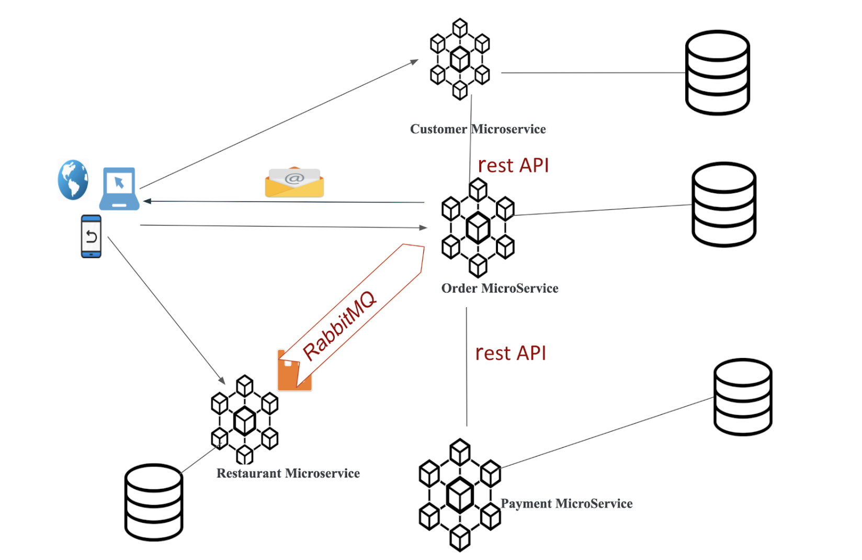

Slide 7
Properties File-(GITHUB)
Restaurant Microservice
RM DB
Config Server
RabbitMq
Customer Microservice
CM DB
Eureka Server
Order Microservice
OM DB
Feign
Admin Microservice
Payment Microservice
PM DB
Feign

Slide 8
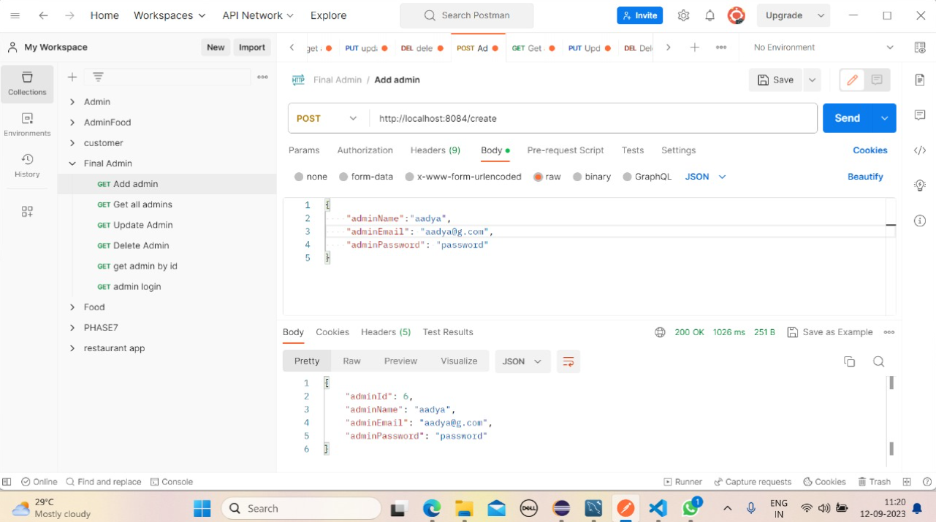
Admin Microservices

Slide 9
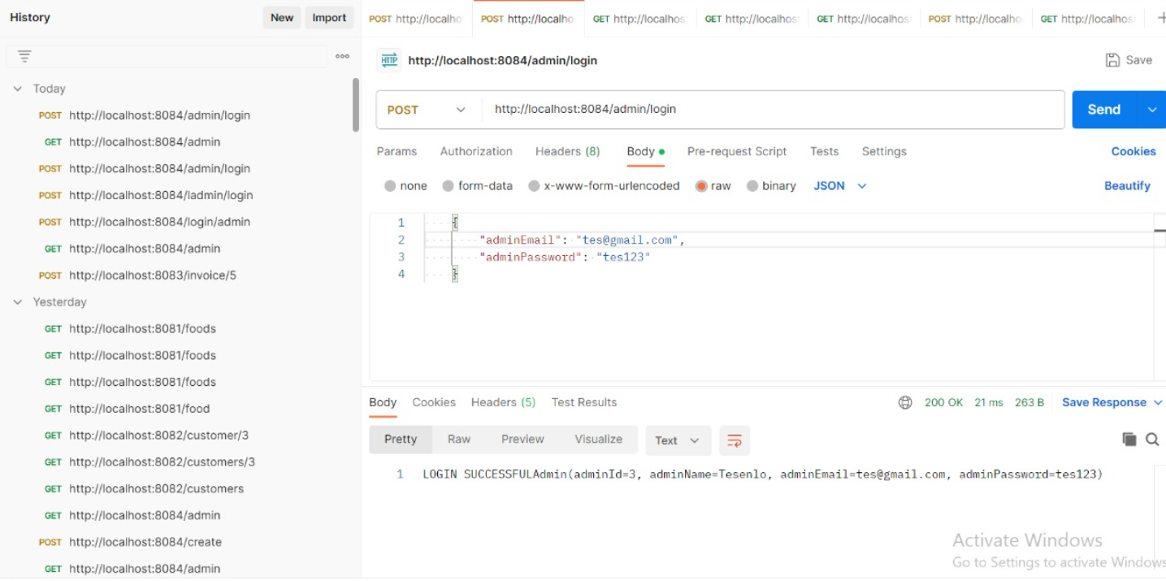

Slide 10
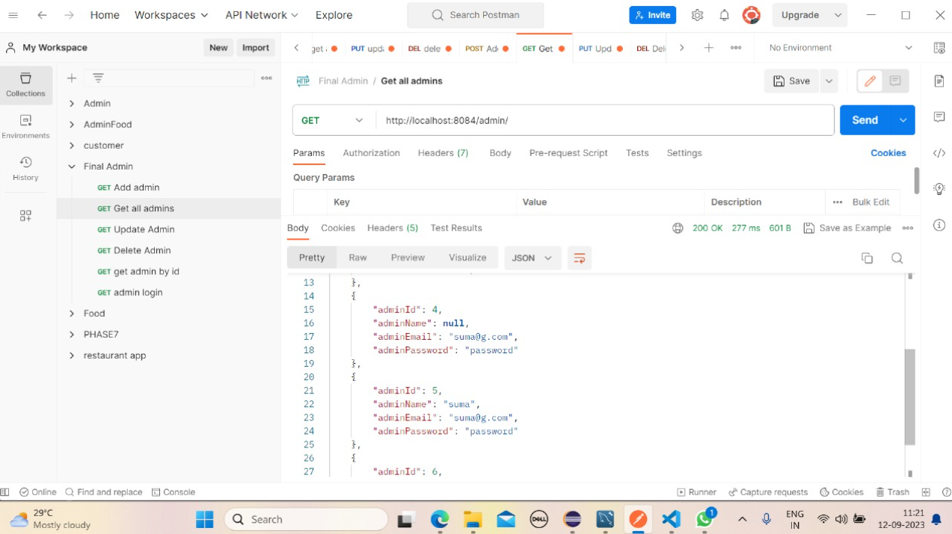

Slide 11
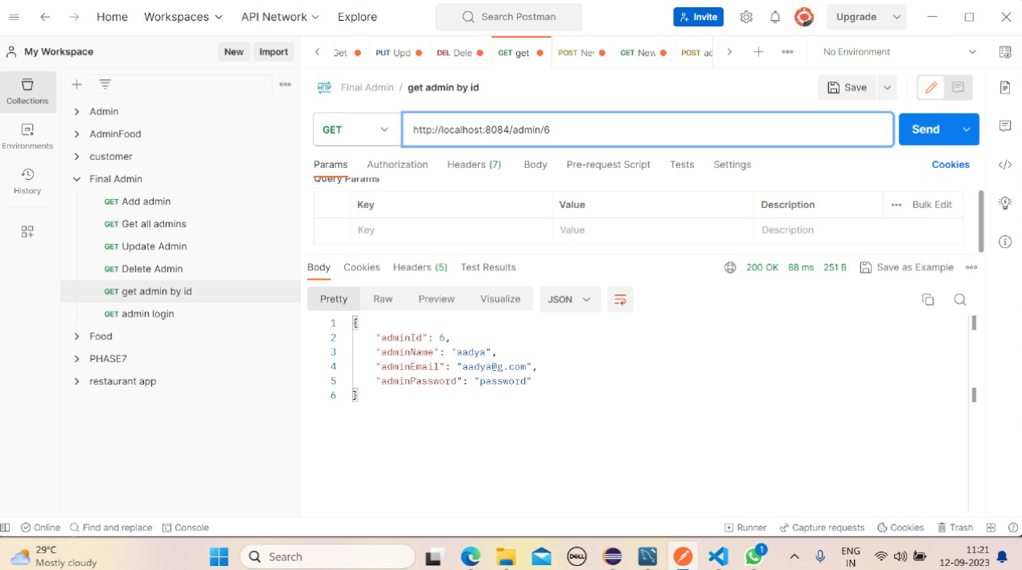

Slide 12
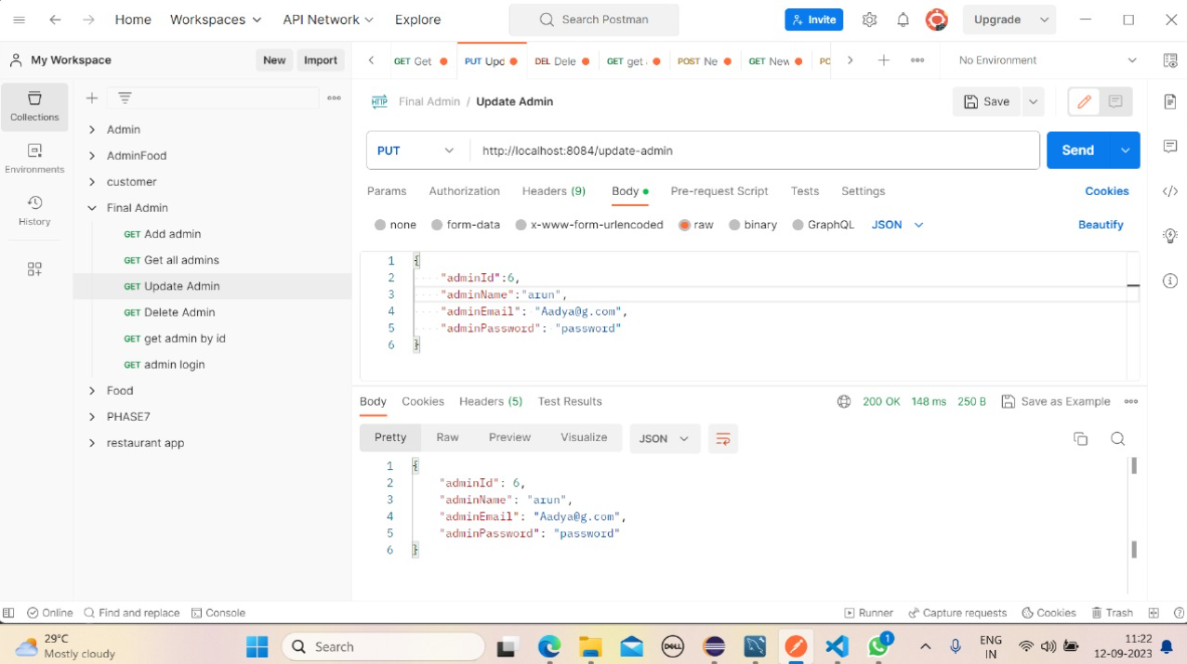

Slide 13
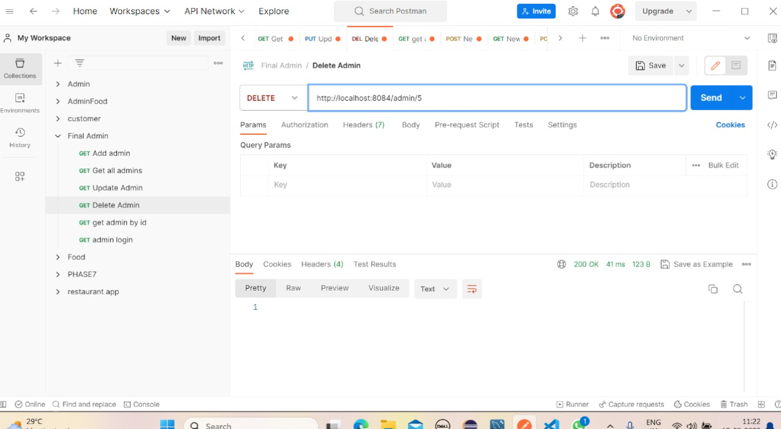

Slide 14
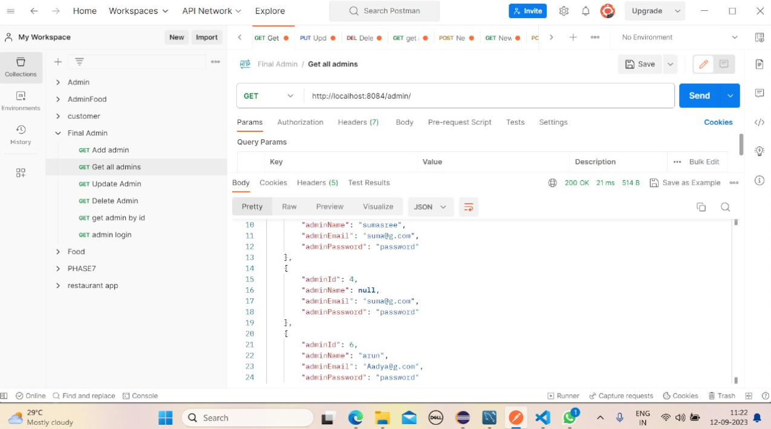

Slide 15
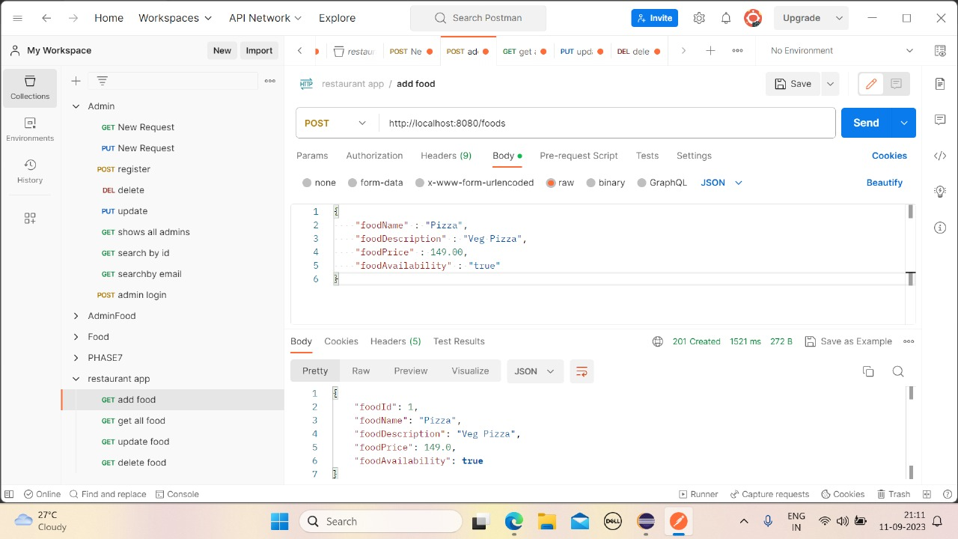
Restaurant Microservice

Slide 16
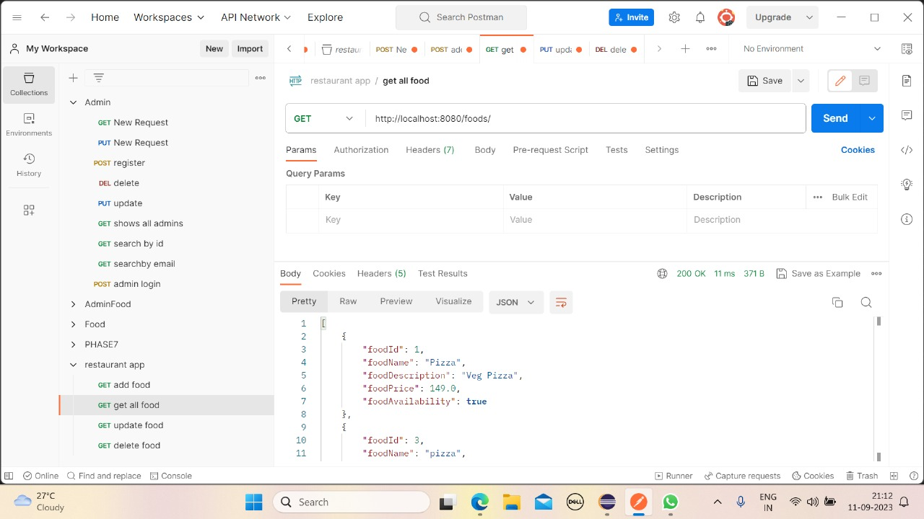

Slide 17
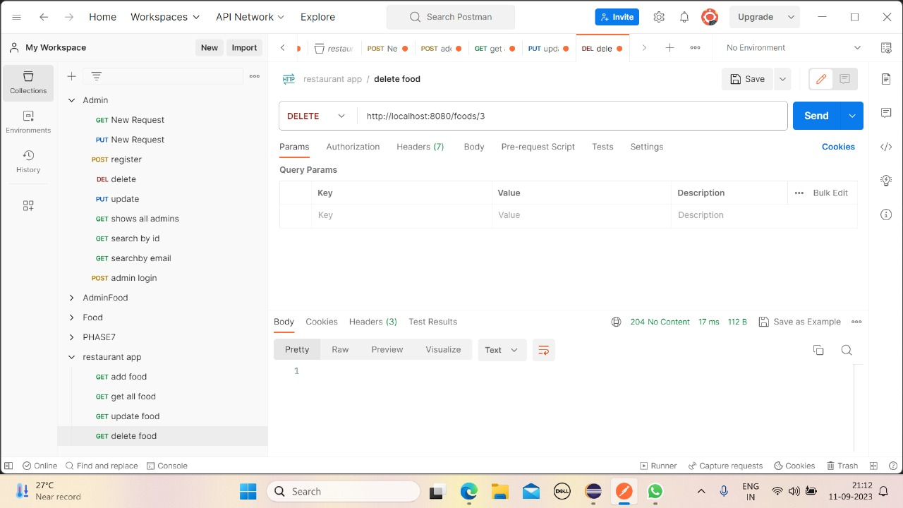

Slide 18
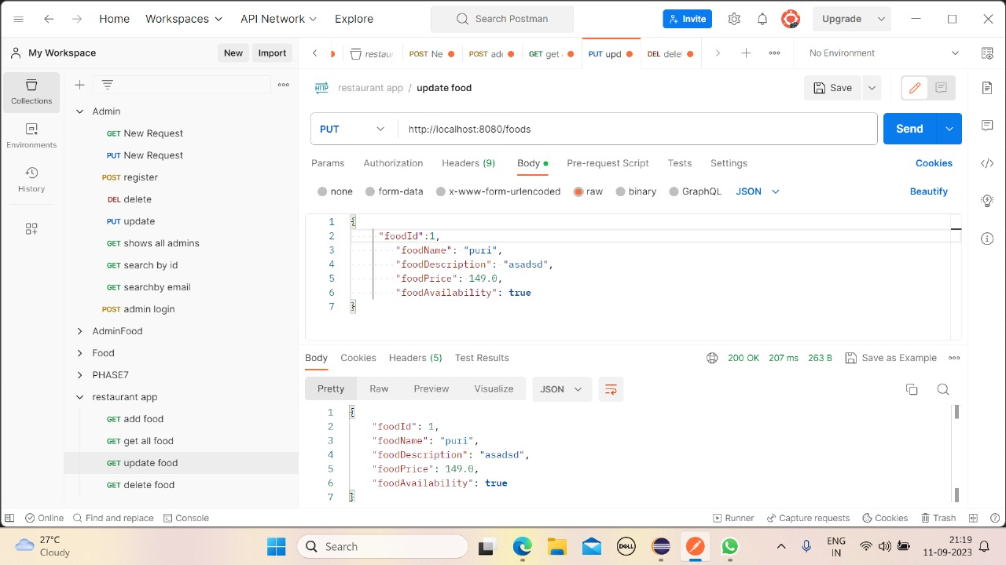

Slide 19
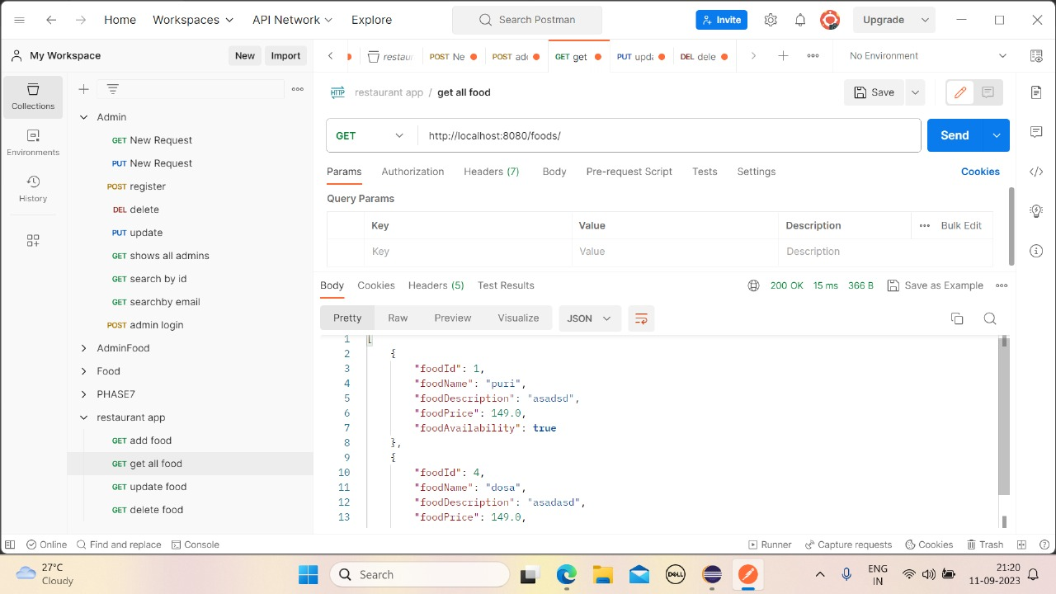

Slide 20
Module:Customer
● Registration of Customer
● Login
● List of Customers
● Customer By Id
● Update Customer Details
Features used in Customer-Microservice
● Config-Server
● Eureka
● Sleuth-Zipkin

Slide 21
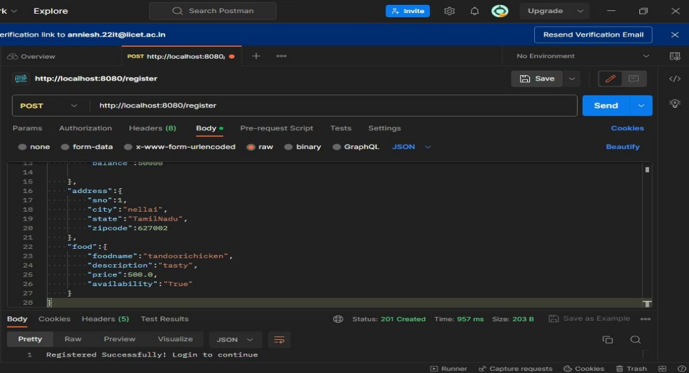
Customer Microservice

Slide 22
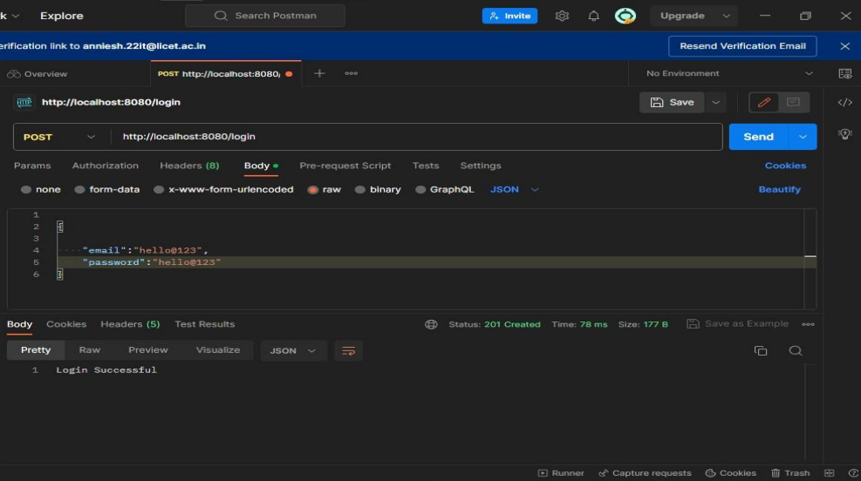

Slide 23
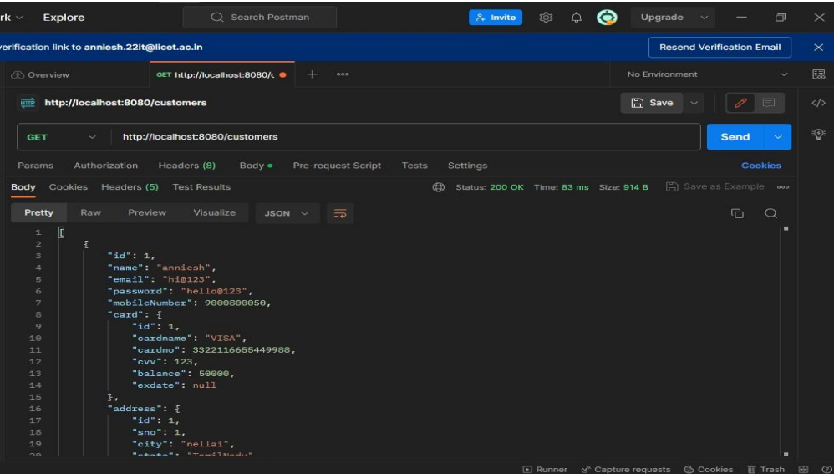

Slide 24
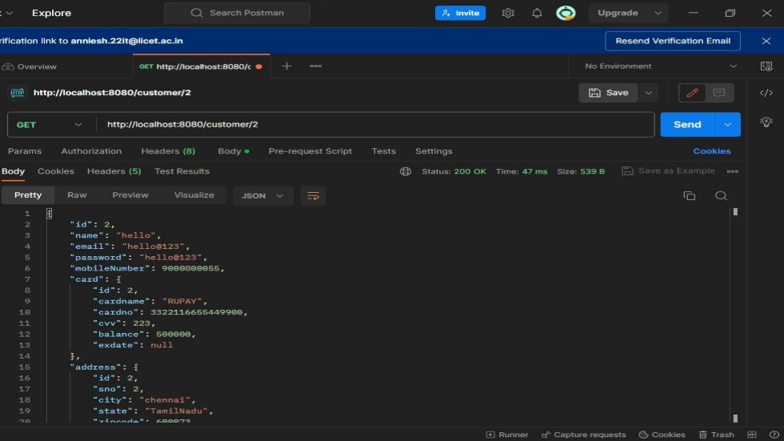

Slide 25
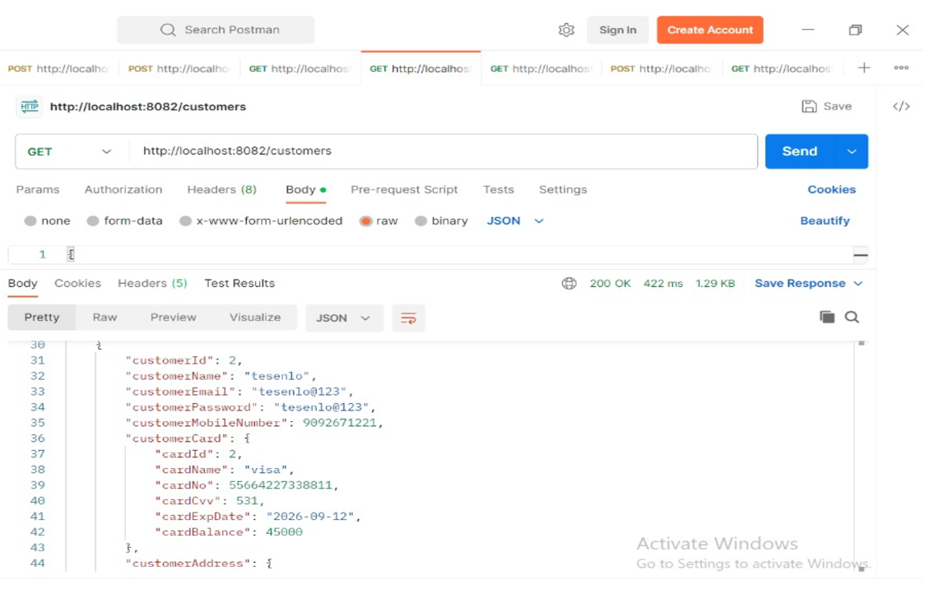

Slide 26
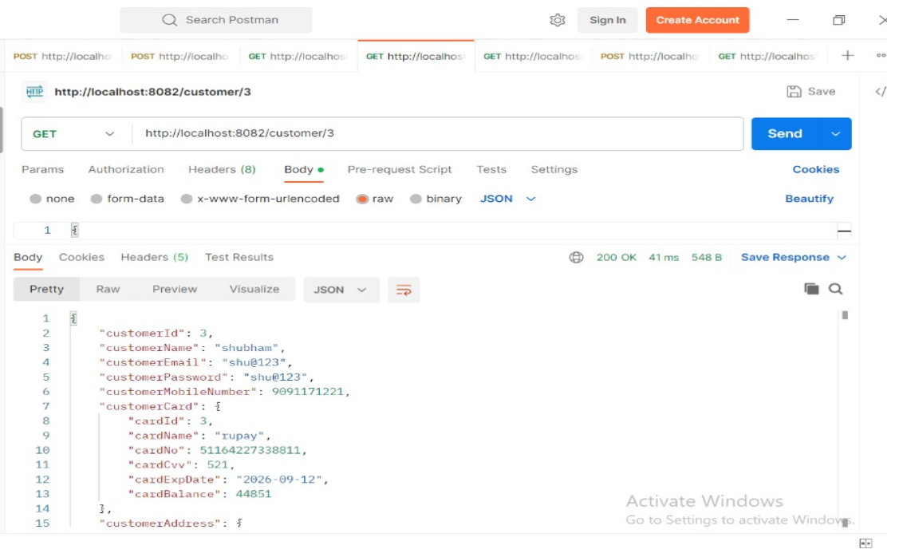

Slide 27
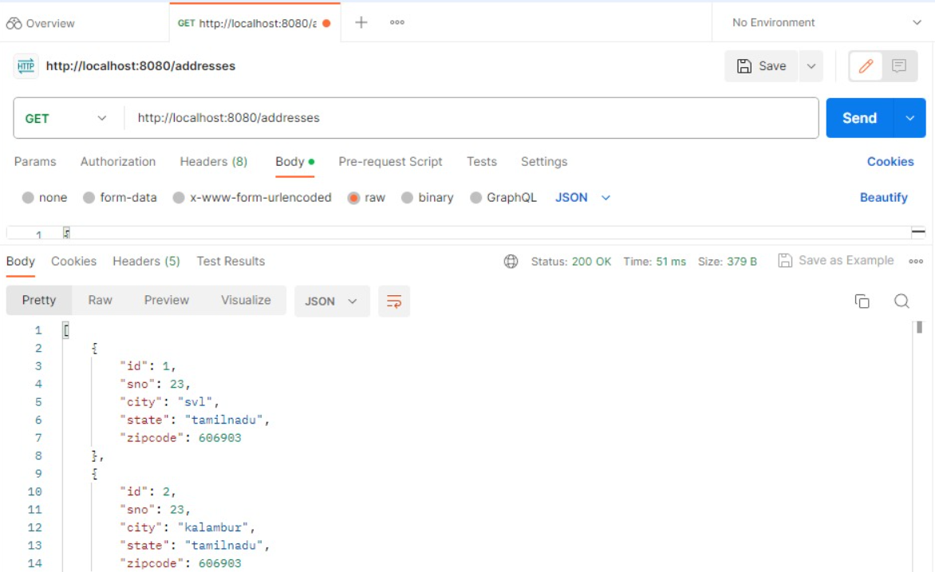

Slide 28
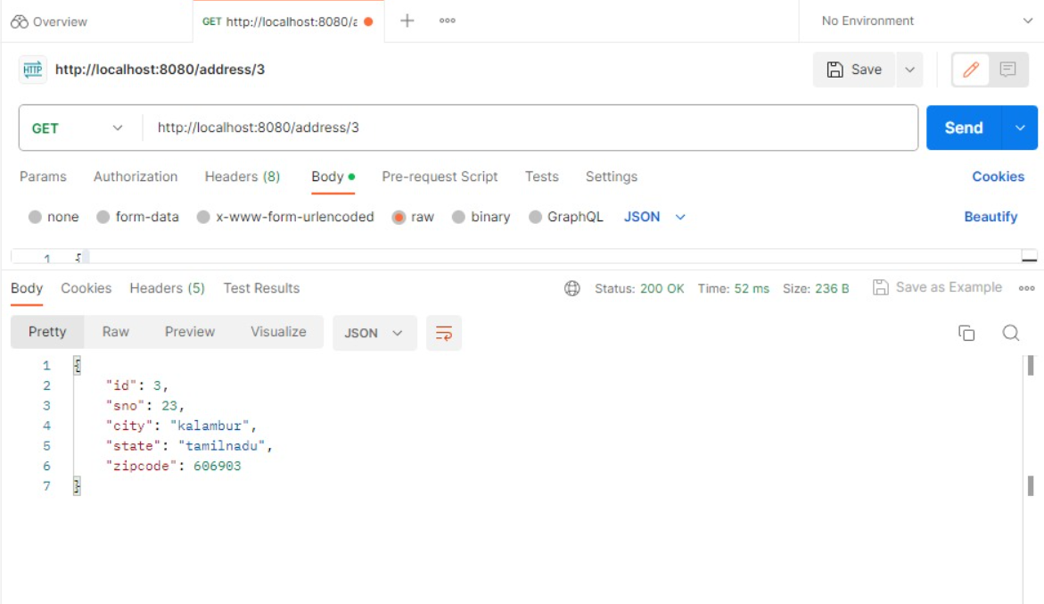

Slide 29
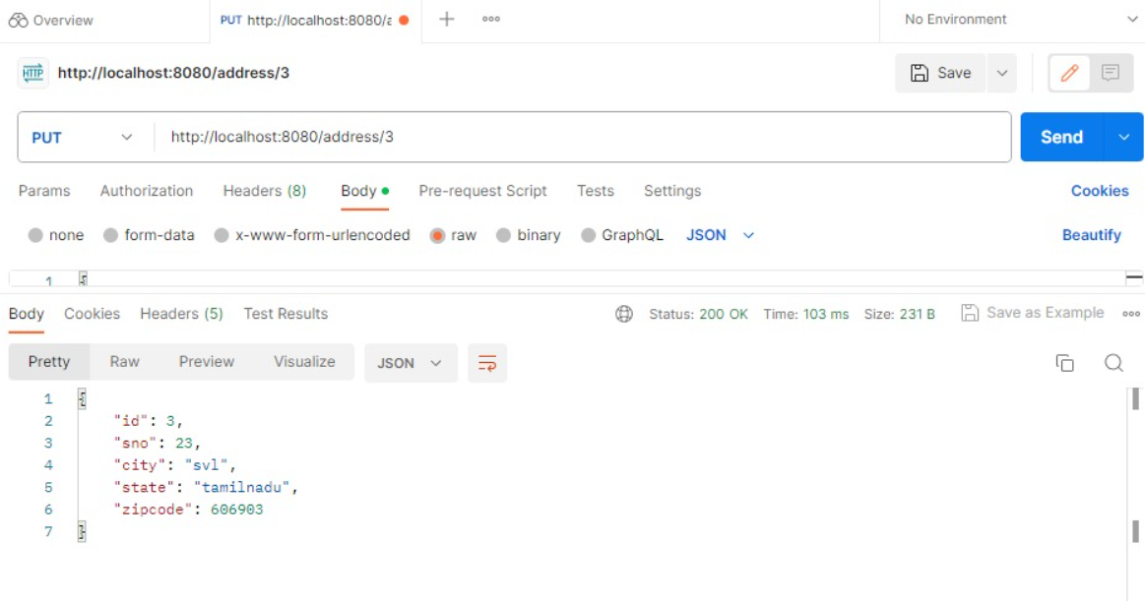

Slide 30
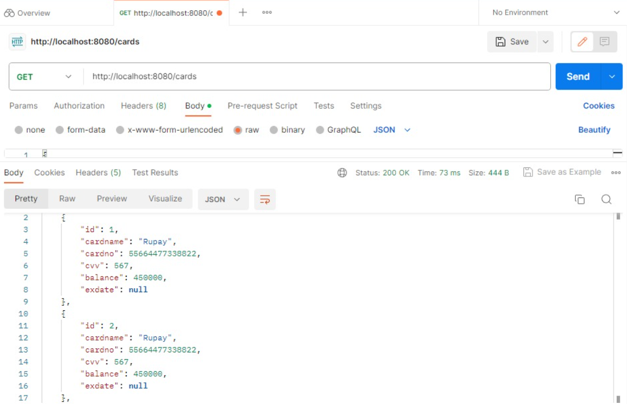

Slide 31
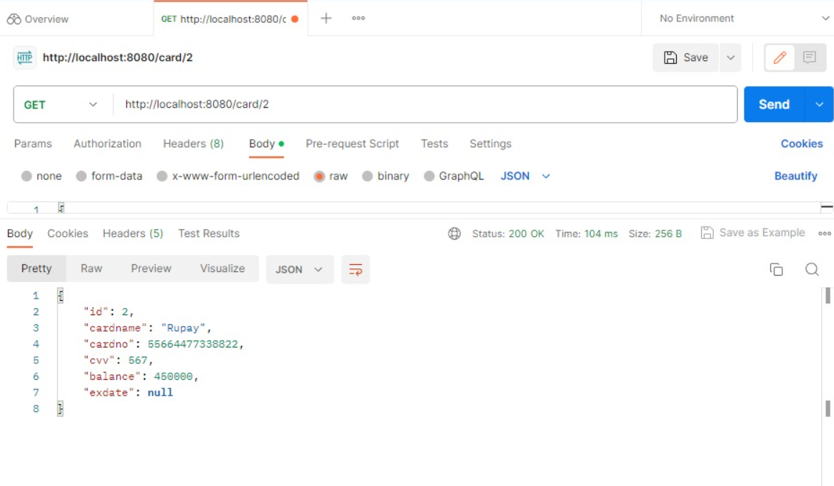

Slide 32
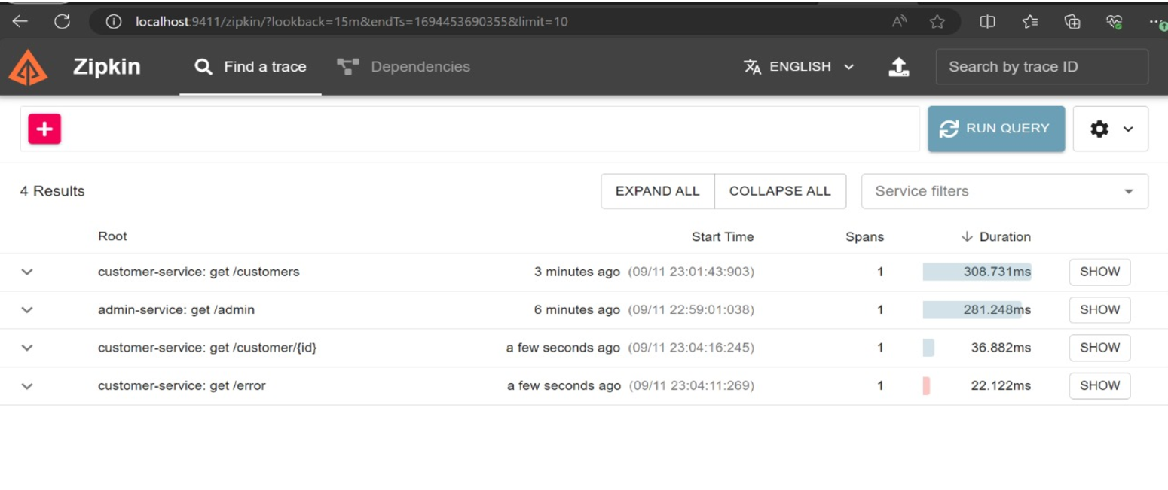

Slide 33
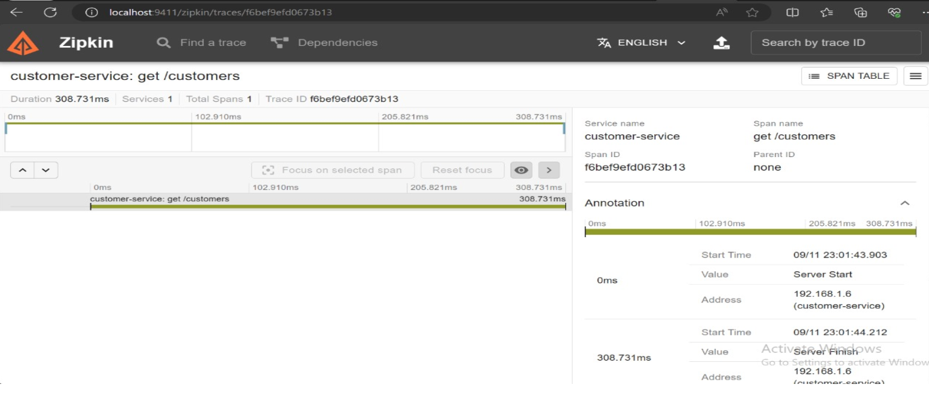

Slide 34
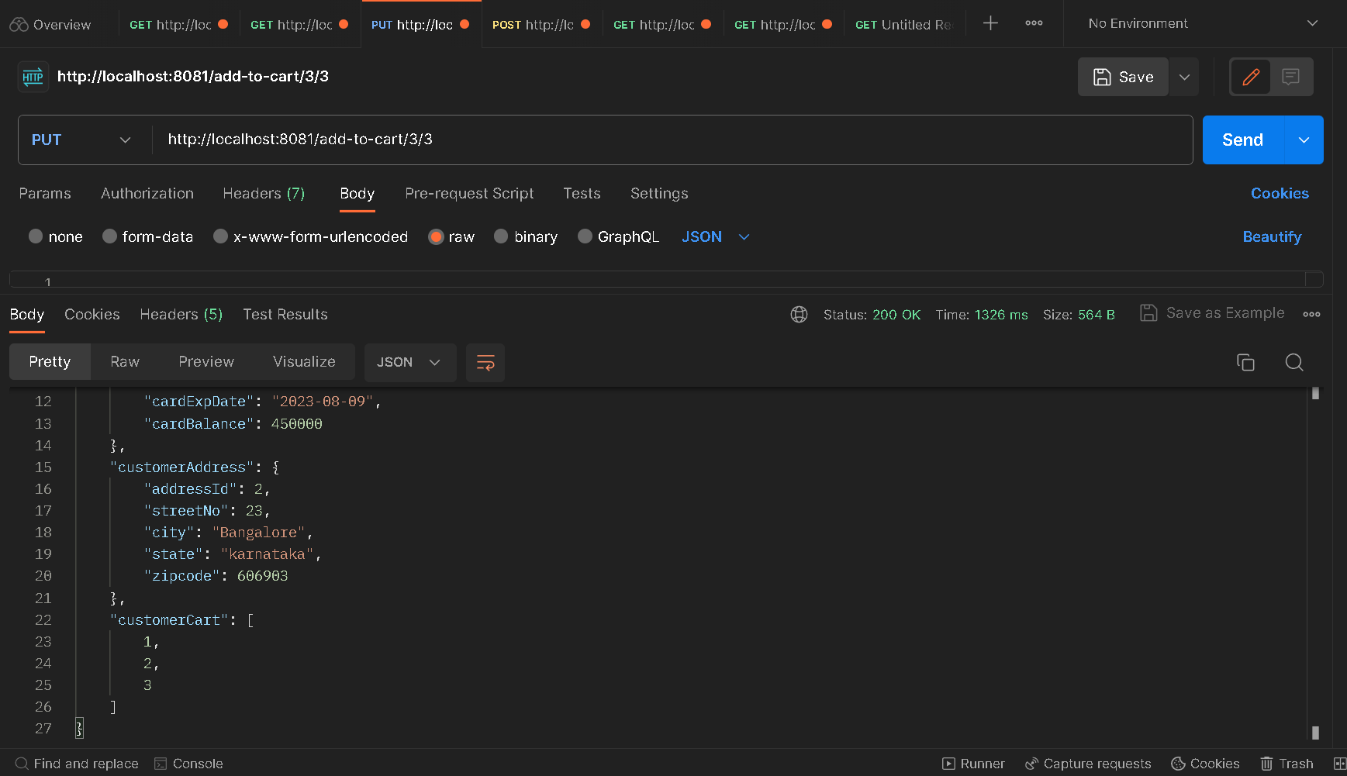
Order Microservices

Slide 35
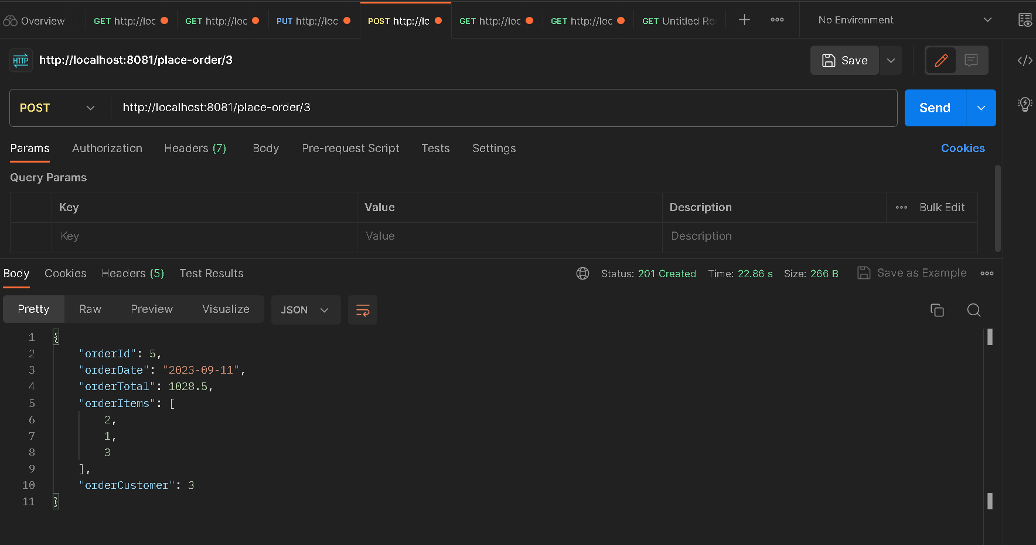

Slide 36
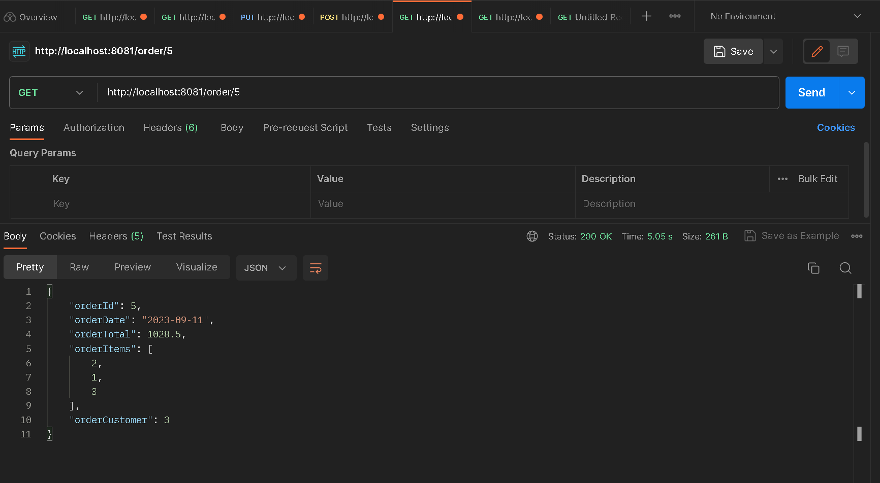

Slide 37
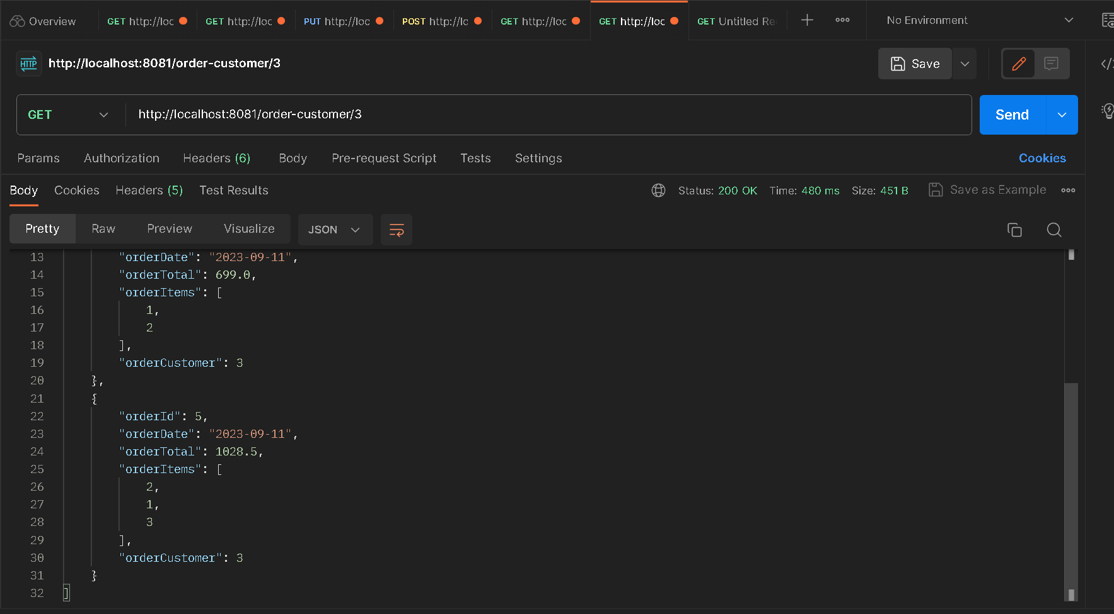

Slide 38
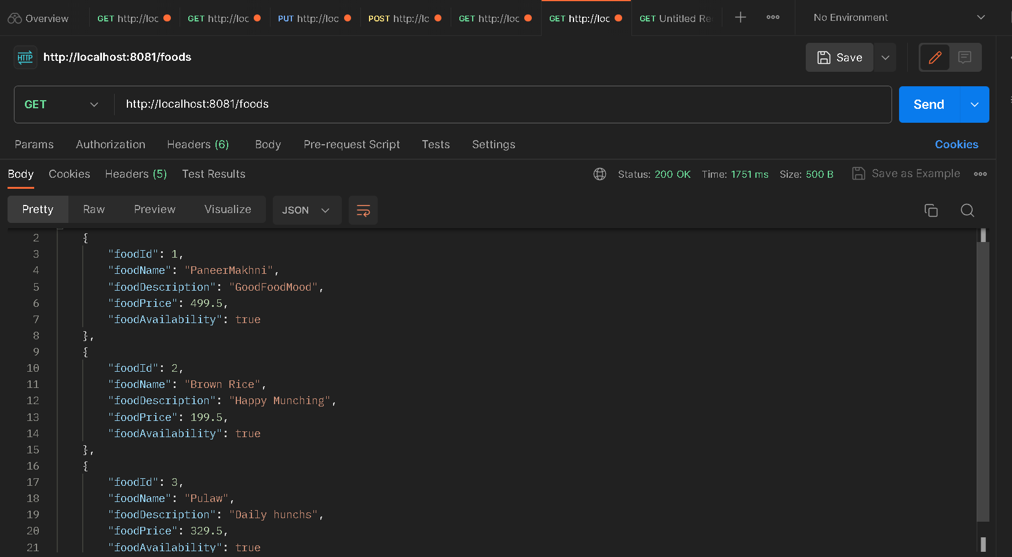

Slide 39
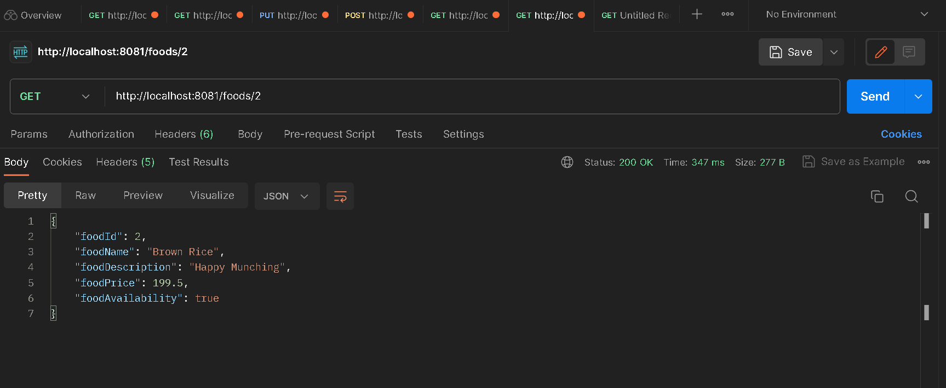

Slide 40
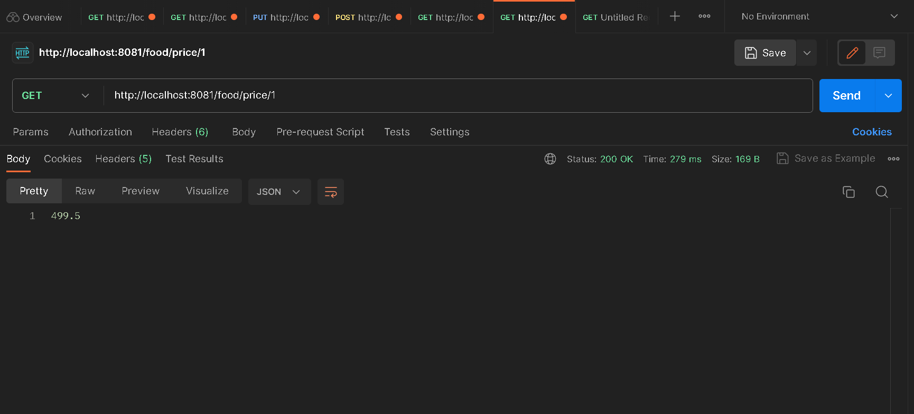

Slide 41
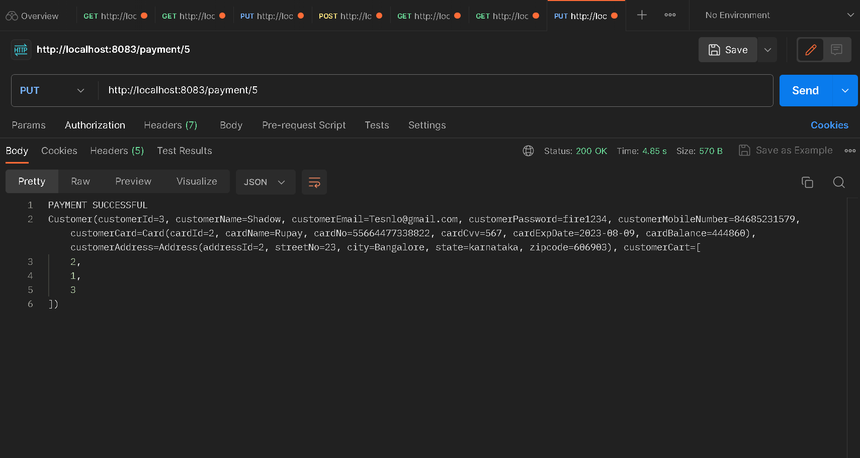
Payment Microservices

Slide 42
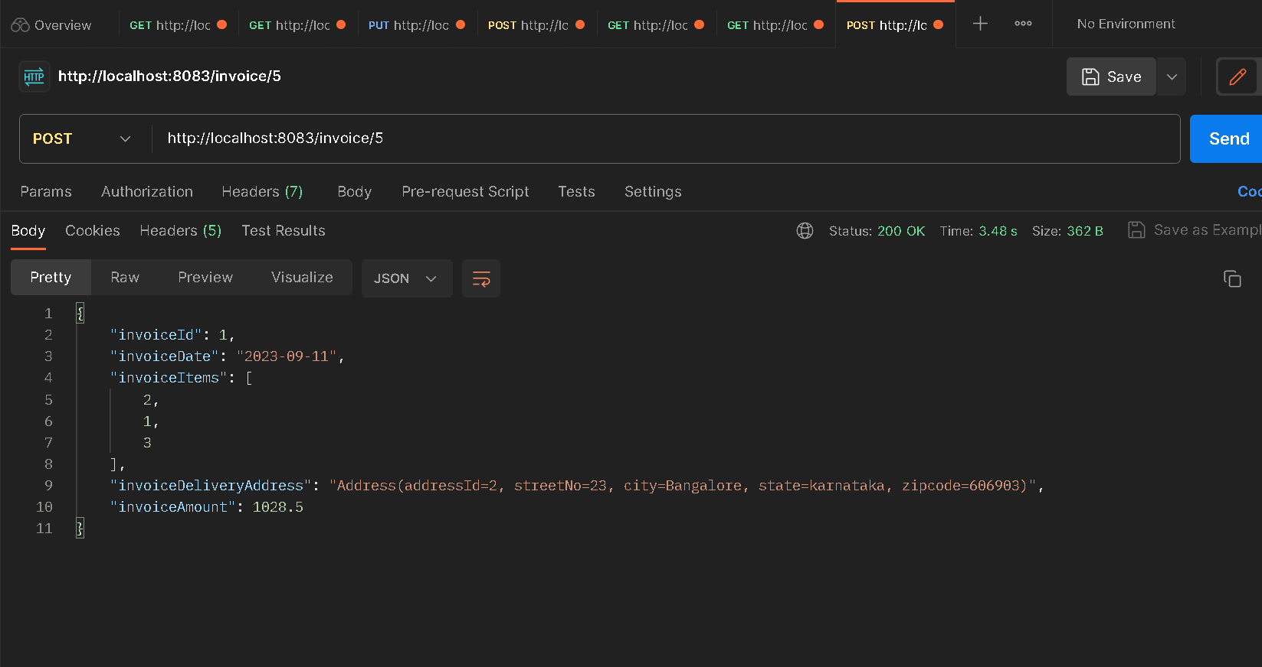

Slide 43
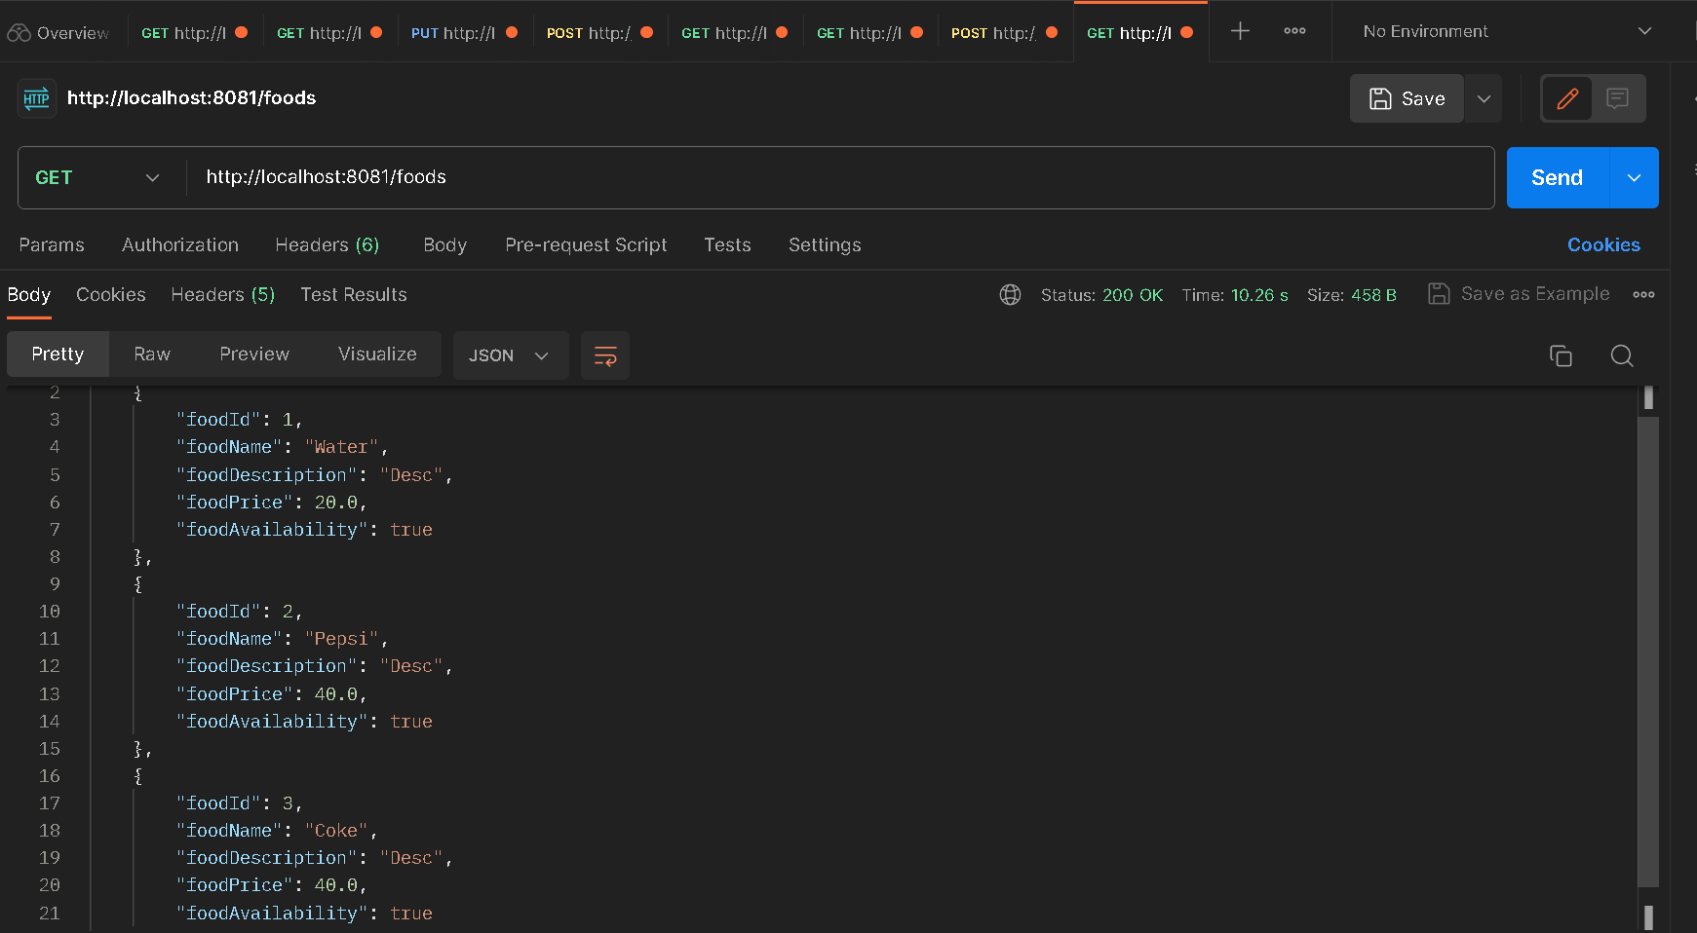
Retry and Resilience4J

Slide 44
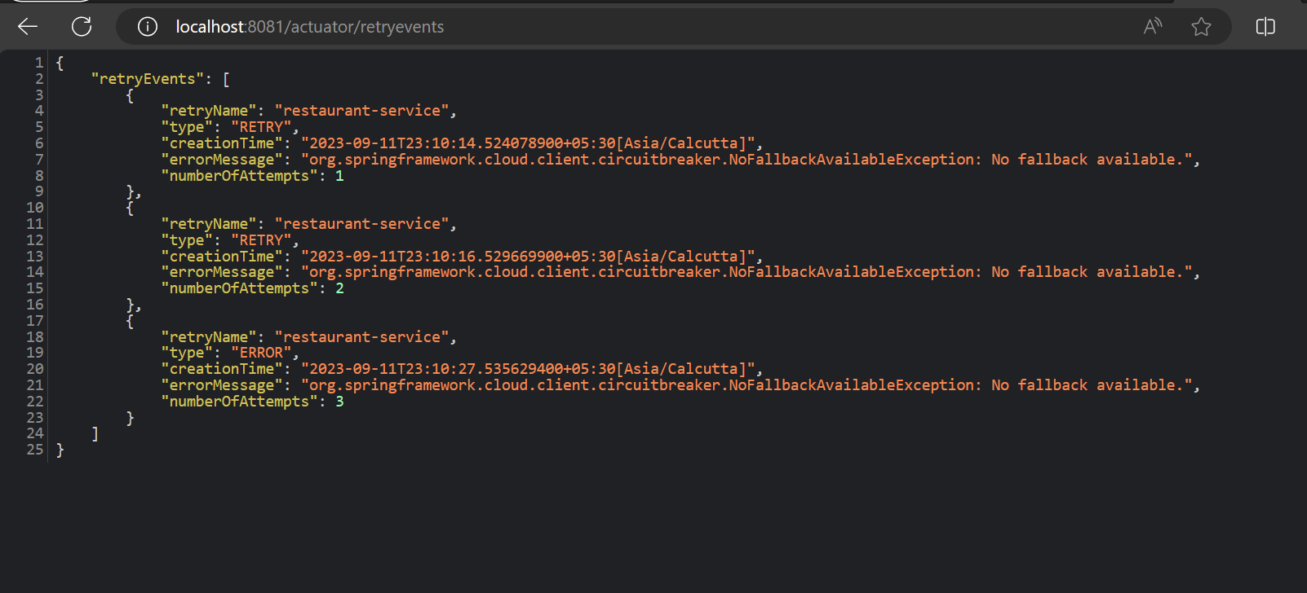

Slide 45
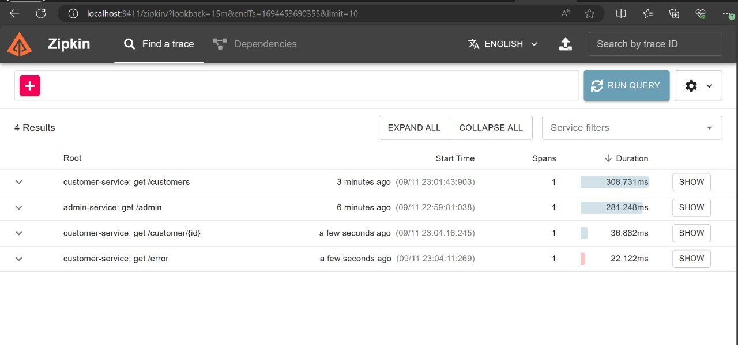
Zipkin and Sleuth

Slide 46
Thank You

